Slide 1
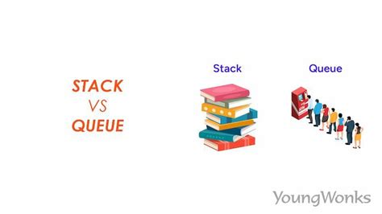
Linear Data Structures
Queues and Stacks

Slide 2
Today
Check in
GE02 and Quiz 02
Goals:
Describe and implement linear data structures that model real-world problems:
Stacks (LIFO) for last-in-first-out processing.
Queues (FIFO) for first-in-first-out processing.
Describe and implement linear data structures that model real-world problems:
Stacks (LIFO) for last-in-first-out processing.
Queues (FIFO) for first-in-first-out processing.
Explain and apply generics to create reusable, type-safe classes and methods that work with multiple object types.
Set Up
Open your library app

Slide 3
Quiz 2
Look at objectives
The exam is 60 points containing
(10pts)Part 1: 5 TF
(10pts)Part 2: 5 Matching
(10pts)Part 3: Short Answer
(10pts)Part 4: Explanation
(10pts)Part 5: Error Analysis and Fix Code
(10pts)Part 6: Write Code

Slide 4
Understanding Generics
A generic class or method lets us define code that works with different types safely.
A generic type is a placeholder for the real data type.
The actual type is specified when you create the object.
Why use generics? • Stronger type checking at compile time • Avoids type casting when retrieving items • Supports code reuse for multiple data types • Improves software reliability and readability
Same code structure, different data types — no duplication needed!

Slide 5
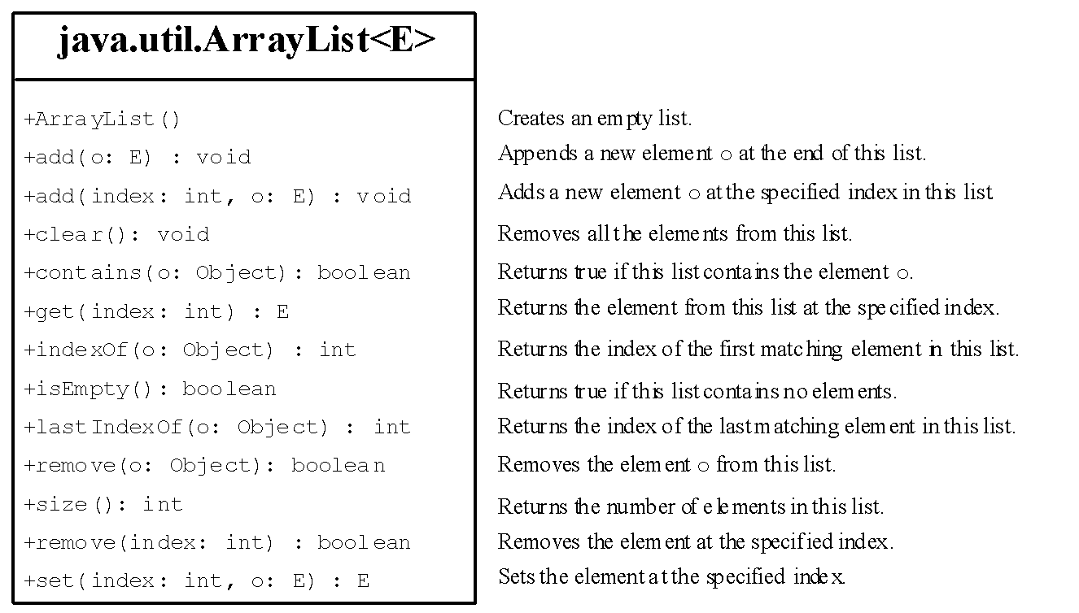
ArrayList
ArrayList is a generic class
Can create an ArrayList object for holding any type.
Generic type E will be replaced with a concrete type such as - String, Integer, etc.
Think of “E” as a placeholder for any concrete type of element ArrayList will hold

Slide 6
Generic Type Safety
Generics enforce type safety.
This prevents errors where the wrong kind of object is stored or used.
Generics provide compile-time type checking, errors are caught before the program runs, making your code safer, cleaner, and easier to maintain.
Without generics:
ArrayList items = new ArrayList();
items.add("Hello");
items.add(10); // Compiler allows this — no type checking!
String s = (String) items.get(1); // Causes runtime error
With generics:
ArrayList<String> items = new ArrayList<>();
items.add("Hello");
// items.add(10); // Compiler error — type mismatch!
String s = items.get(0); // Safe, no casting needed

Slide 7
ArrayList is a Generic Class
To use an ArrayList, note that must import java.util.ArrayList
ArrayList<String> myList = new ArrayList<>();
ArrayList<Animal> zooAnimals = new ArrayList<>();
Declaring: notice the difference when declaring a regular array vs ArrayList
int[] integerArray = new int[10];
ArrayList<Integer> myList = new ArrayList<>();
Array of objects or ArrayList of objects – very similar!
Dog[] dogs = new Dog[10];
ArrayList<Dog> dogs = new ArrayList<>();
Regular brackets are used
Angle brackets are used and parenthesis
Array of dog objects - must specify the size of array
ArrayList of dog objects – don’t specify size

Slide 8
Data Structures: Representing Information
Representing information is fundamental in computer science.
Development of commercial applications involves the development of complex and interacting structures.
Computer programs need to store, retrieve, and manipulate data – as fast as possible!
Data Structures:
Any representation of data and its associated operations.
An organization or structuring for a collection of data items.
Examples
A sorted list of integer values stored in an array is a data structure.
Text editing operations stored on a stack is another data structure.
Decisions to make based on a current state stored in a tree.
Data Structures: Learn correct data structure
Algorithms: Learn what algorithms to use to to store the data

Slide 9
Linear Data Structures
Now that we can store objects generically, let’s explore how we organize them — starting with linear data structures.
What Is a Linear Data Structure?
A linear data structure stores elements in sequence.
Each element connects to the one before and after it.
 | Examples | Access Order
Sequential organization | Array, ArrayList, Stack, Queue | One element follows another
Simple traversal | Iterate front → back or back → front | Preserves order of insertion

Slide 10
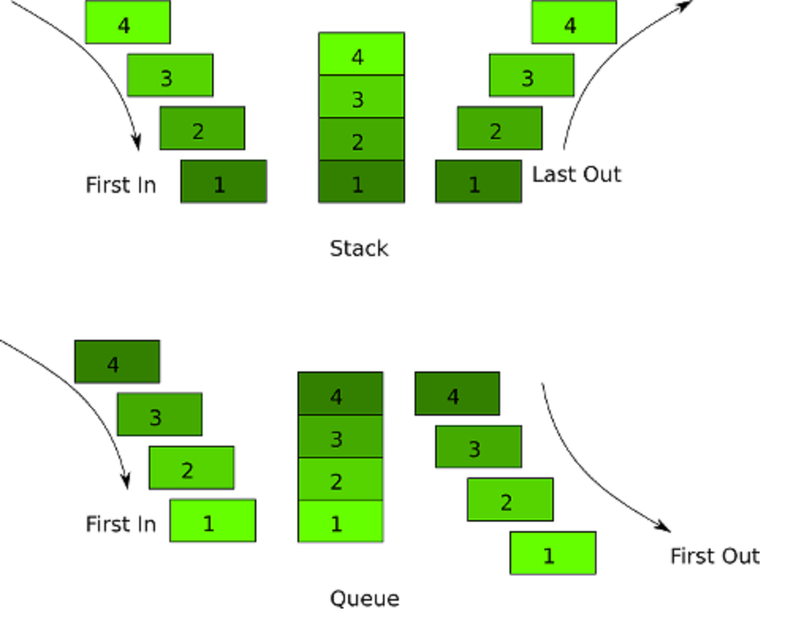
Where are Stacks and Queues Used?
In your own words — what real-world process acts like a stack? Like a queue?

Slide 11
Stack Applications
Stacks have many interesting applications.
For example, whenever a function call is made, the called function must know how to return to its caller, so the return address is pushed onto a stack.
If a series of function calls occurs, the successive return values are pushed onto the stack in last-in, first-out order so that each function can return to its caller.
Stacks support recursive function calls in the same manner as conventional non recursive calls.
Stacks contain the space created for automatic variables on each invocation of a function.
When the function returns to its caller, the space for that function's automatic variables is popped off the stack, and these variables no longer are known to the program.
Stacks are used by compilers in the process of evaluating expressions and generating machine-language code.
Undo/Redo in Text Editors
Press Undo → last action removed
Press Redo → restore last action
Browser History
Back/Forward buttons → stack-based

Slide 12
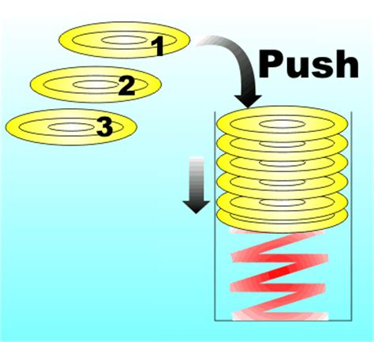
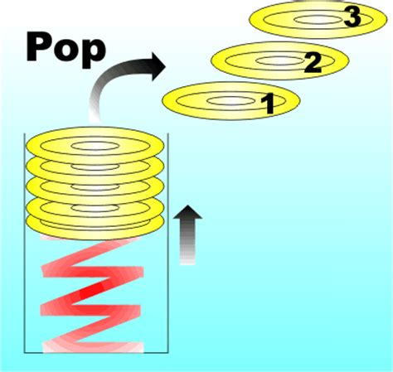
Stack Last In First Out (LIFO)
Stack is an ordered linear collection
Insertions and deletions are made only at the top of the stack (this is the end of the list)
Elements are added in a last in first out (LIFO) manner
Think of a Stack of plates - animation
Plates in a banquet line for a stack.
The last plate placed on the stack is the first plate to be removed.
Removal is only done from the top of the stack of plates.
Data Structures: Stacks

Slide 13
The Stack Abstract Data Type
Operations
Stack() creates a new stack that is empty. It needs no parameters and returns an empty stack.
push(item) adds a new item to the top of the stack. It needs the item and returns nothing.
pop() removes the top item from the stack. It needs no parameters and returns the item. The stack is modified.
peek() returns the top item from the stack but does not remove it. It needs no parameters. The stack is not modified.
isEmpty() tests to see whether the stack is empty. It needs no parameters and returns a boolean value.
size() returns the number of items on the stack. It needs no parameters and returns an integer.
Stack Abstract Data Type

Slide 14
Pop and Peek Exception
Why NoSuchElementException for Stacks?
A stack follows LIFO (Last-In, First-Out).
When pop() or peek() is called on an empty stack, it means there is no valid element to return.
NoSuchElementException: when an operation attempts to retrieve an element from an empty collection.

Slide 15
Abstract Data Types (ADTs)
An Abstract Data Type (ADT) defines the behavior and operations of a data structure without specifying its implementation.
Example: The Stack ADT specifies:
push(value): Add an element to the top.
pop(): Remove and return the top element.
peek(): View the top element without removing it.
However, the implementation of a stack can vary:
Using an array (fixed size).
Using an ArrayList (dynamic resizing).
Using a linked list (efficient insertions and deletions).
This separation of concerns allows programmers to use stacks and queues in an abstract way, choosing an implementation that best suits their performance needs.

Slide 16
Lab: Generic with ArrayList
Import this stack StackTest.java and use the debugger to explore.
Note: This program is meant to help you understand how a stack works internally — how push, pop, and peek behave, and how exceptions are used when the stack is empty. It’s not meant to be a full application, just a short test driver to visualize the stack in action.
Discuss
How do stacks work?
Why use generics?
How do generics eliminate the need for casting collections?
Why use an arrayList over an array?
When using pop and peek what can go wrong?
Implement
Add another stack for strings

Slide 17
Lab Stack Test ADT Part and Generic Part
Stack<T>
ADT part (what it does): push, pop, peek, isEmpty, size.
Generic part (how it stays type-safe & reusable): the type parameter <T> lets you create Stack<Integer>, Stack<String>, etc., with compile-time type checking.
Implementation detail: uses ArrayList<T> internally. You don’t care how it stores (that’s the implementation); they use it via the ADT operations.
Both stacks run the same code (the same algorithm).
The only difference is the type of element they store (Integer vs String).
The compiler knows what each stack holds
Stack<Integer> numberStack = new Stack<>();
numberStack.push(10);
numberStack.push(20);
Stack<String> wordStack = new Stack<>();
wordStack.push("Hello");
wordStack.push("World");

Slide 18
Lab Stack Test Demonstrates
Concept | Where It Appears | Explanation
Generic ADT | class Stack<T> | Shows how to create a type-safe stack that works for any data type (Integer, String, etc.)
Encapsulation | private ArrayList<T> items | Data is hidden inside the stack; only stack operations are visible
Core Stack Operations | push(), pop(), peek(), isEmpty() | Demonstrates Last-In–First-Out (LIFO) behavior
Exception Handling | throw new NoSuchElementException("Stack is empty.") | Prevents invalid operations and models safe software design
toString() | returns "bottom -> [ ... ] <- top" | Lets students visualize stack order after each operation

Slide 19
Abstract Classes in Comparison to Generics
Concept | Abstract Class (M03 L14) | Generics (M03 L15)
Purpose | Provides a base structure but leaves details for subclasses | Allows flexible type assignment without needing multiple classes
Customization | Subclasses override abstract methods | Type parameter <T> is replaced with any type
Example | abstract class Animal { abstract void makeSound(); } | class Stack<T> { private ArrayList<T> items; }
Generics: Allow one class (e.g., Stack<T>) to handle multiple data types safely. Example: Stack<Integer> vs. Stack<String>
ADT: Defines what operations a structure supports, not how they’re implemented. Example: Stack ADT operations remain the same whether implemented with ArrayList or linked list.

Slide 20


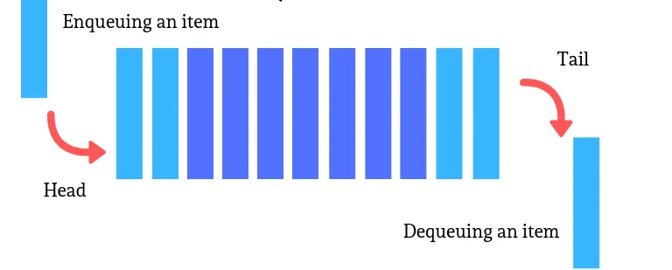
Queues First In First Out (FIFO)
Stacks handle LIFO tasks; what if we need the first item to finish first?
Queues
Another common data structure is the queue.
A queue is similar to a checkout line in a grocery store—the first person in line is serviced first, and other customers enter the line only at the end and wait to be serviced.
Queue nodes are removed only from the head of the queue and are inserted only at the tail of the queue.
For this reason, a queue is referred to as a first-in, first-out (F I F O) data structure.
The insert and remove operations are known as enqueue and dequeue, respectively.
Explore animation/Queue

Slide 21
Application of Queues
Information packets also wait in queues in computer networks.
Each time a packet arrives at a network node, it must be routed to the next node on the network along the path to its final destination.
The routing node routes one packet at a time, so additional packets are enqueued until the router can route them.
Queues are also used to support print spooling.
Many users may be generating outputs to be printed.
If the printer is busy, other outputs may still be generated.
These are spooled to disk where they wait in a queue until the printer becomes available.
For computers that have only a single processor, only one user at a time may be serviced.
Entries for the other users are placed in a queue.
Each entry gradually advances to the front of the queue as users receive service.
The entry at the front of the queue is the next to receive service.

Slide 22
The Queue Abstract Data Type
enqueue() – Add an element to the rear.
queue.add(item);
dequeue() – Remove and return the front element.
if (!queue.isEmpty()) {
return queue.remove(0);
}
throw new IllegalStateException("Queue is empty.");
peek() – Return the front element without removing it.
if (!queue.isEmpty()) {
return queue.get(0);
}
throw new IllegalStateException("Queue is empty.");
isEmpty() – Check if the queue is empty.
return queue.isEmpty();
Java’s Queue behavior, use IllegalStateException.
Java’s Stack behavirot, use NoSuchElementException.

Slide 23
Linear Data Structures: Stacks Versus Queues
Different applications require different ways of storing, accessing, and modifying data based on their needs:
When to use
Stacks are best when you need LIFO ordering (undo/redo, function calls).
Queues are best when you need FIFO ordering (task scheduling, customer service).
Both can be implemented using ArrayList, ensuring dynamic memory allocation.
Both can be implemented using an ArrayList, with generics for flexibility and exceptions for safety.
Feature | Stack (LIFO) | Queue (FIFO)
Insertions | push() (top) | enqueue() (rear)
Removals | pop() (top) | dequeue() (front)

Slide 24
Generic ADT (explicit <T>)
The data structure doesn’t know or care what type it stores — you tell it when you create it.
That’s what <T> represents: a type parameter.
Lab StackTest: Stack class Here <T> is explicit when you define it right in the class header.
class Stack<T> {
private ArrayList<T> items = new ArrayList<>();
public void push(T item) { items.add(item); }
}
When you use it
Stack<Integer> intStack = new Stack<>();
Stack<String> wordStack = new Stack<>();
Use a generic ADT when:
The structure could be reused for different types (e.g., Integer, String, Customer).
You’re building a library, tool class, or data structure (Stack, Queue, List, etc.).
You want compile-time type safety and reusability.

Slide 25
Lab: Customer Service Queue
Implement a queue-based system where customers are added to a service queue and served in a first-come, first-served manner. See Customer Service Queue System Sample Output
Allow users to:
Add customer to queue (enqueue)
Serve next customer (dequeue)
View next customer (peek)
Display queue
Exit
For the customer service queue you will implement an implicit type for your ArrayList queue.

Slide 26
Specific type (implicit)
The data structure is designed for one specific purpose or one data type.
It still uses generics inside (through ArrayList<Customer>), but not in its own class definition.
class CustomerQueue {
private ArrayList<Customer> queue = new ArrayList<>();
public void enqueue(Customer customer) { queue.add(customer); }
}
Here the type is implicit — it’s baked into the class.
You can’t reuse this queue for Order, String, or Integer objects.
It’s a queue for Customers only.
Use a specific-type implementation when:
The data type won’t change (it’s tied to your domain model).
The goal is to apply a data structure, not design one.

Slide 27
Lab Implement Customer Service Queue
Use L16LabCustomerServiceQueue.java and add
Customer class with attributes name and issueType
CustomerQueue class uses an ArrayList internally to store customers
Implement queue operations:
enqueue(Customer c) → adds a customer to the end
dequeue() → removes and returns the first customer
peek() → returns the first customer without removing them
isEmpty() → returns true if queue is empty
CustomerQueue
- queue: ArrayList<Customer>
+ enqueue(c: Customer): void + dequeue(): Customer + peek(): Customer + isEmpty(): boolean + displayQueue(): void
class CustomerQueue
{
private ArrayList<Customer> queue; // Internal storage for queue elements
// Constructor initializes an empty queue
public CustomerQueue()
{
queue = new ArrayList<>();
}
Customer
- name: String - issueType: String
+ Customer(name: String, issueType: String) + toString(): String

Slide 28
Project
Coming next week
Will use git command line
Set up before next

Slide 29
Preparation

